Slide 1
FINANCIAL ANALYSIS
ELEVATE LABS
Power BI Dashboard
Created By – Roshni Giri

Slide 2
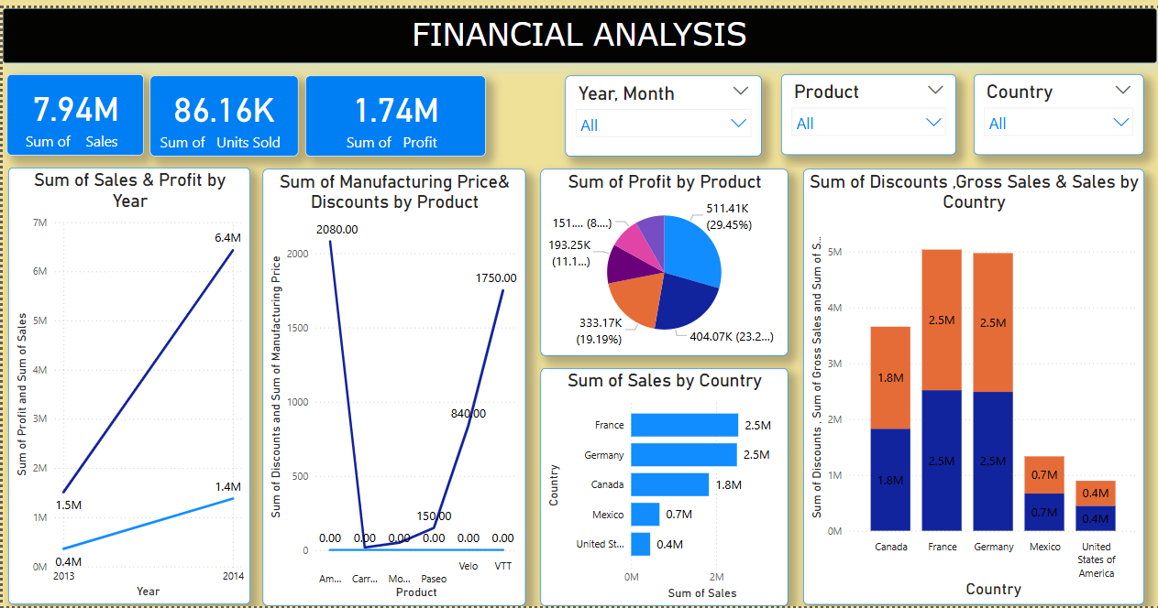
DASHBOARD

Slide 3
OVERVIEW
This dashboard provides a high-level view of financial performance across sales, profit, product categories, and countries. It enables decision-makers to monitor KPIs, identify trends, and explore data interactively using slicers.

Slide 4
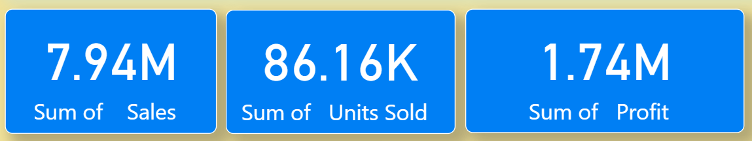
KPI INDICATOR
The top section displays the most important KPIs:
Total Sales: 7.94M
Units Sold: 86.16K
Total Profit: 1.74M
These figures give an immediate snapshot of business volume and profitability.

Slide 5
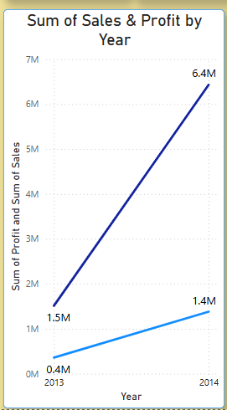
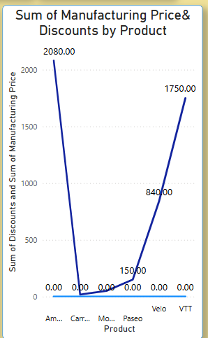
Yearly Trend Analysis
The line chart shows how Sales and Profit have grown over the years.
The second visual compares manufacturing price and discount distribution across products.

Slide 6
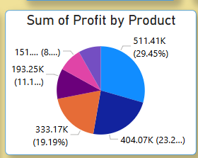
Product-wise Profit Distribution
The pie chart displays profit contribution by each product.
Easily identifies top-performing products
Supports product strategy decisions

Slide 7
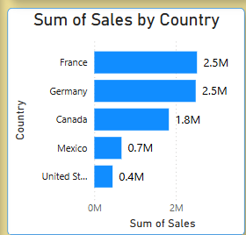
Regional Sales Breakdown
The horizontal bar chart shows sales volume across different countries.
France and Germany lead in sales
Useful for regional performance comparisons

Slide 8
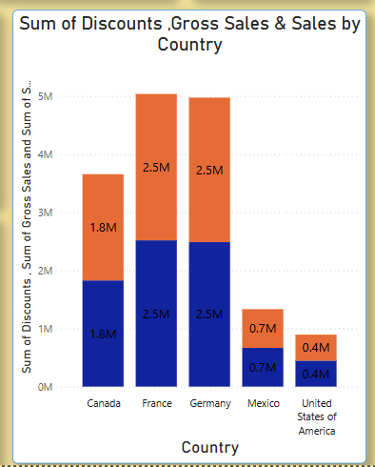
Gross Sales, Sales, and Discounts by Country
The stacked column chart visualizes how discounts affect total gross sales by region.
Highlights the role of discounting in revenue generation
Supports better planning of promotional strategies

Slide 9
Know your material in advance
Anticipate common questions
Rehearse your responses
Maintaining composure during the Q&A session is essential for projecting confidence and authority. Consider the following tips for staying composed:
Stay calm
Actively listen
Pause and reflect
Maintain eye contact

Slide 10
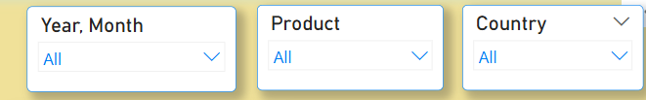
Interactive Filters
Users can filter the dashboard by:
Year and Month Product Country
This enhances analysis flexibility and allows focused data exploration..

Slide 11
Thank you

